Slide 1
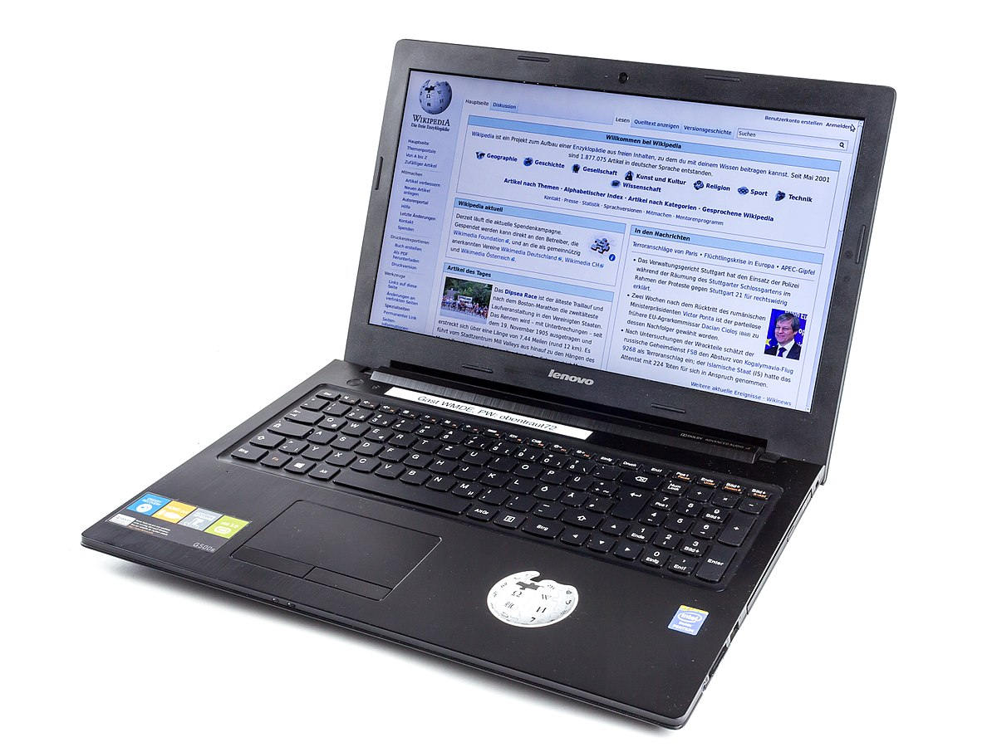
Information Technology in Eureka…2020/2021

Slide 2
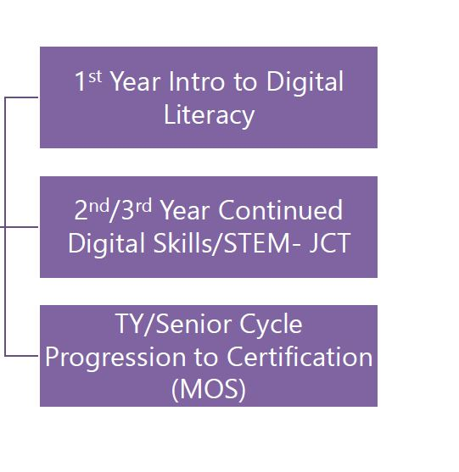
I.T. Course Content 2020/2021

Slide 3
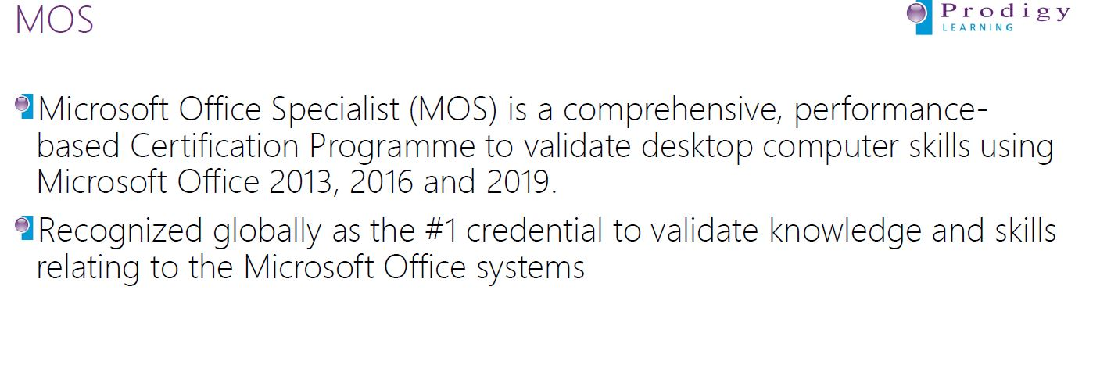
What is MOS?

Slide 4
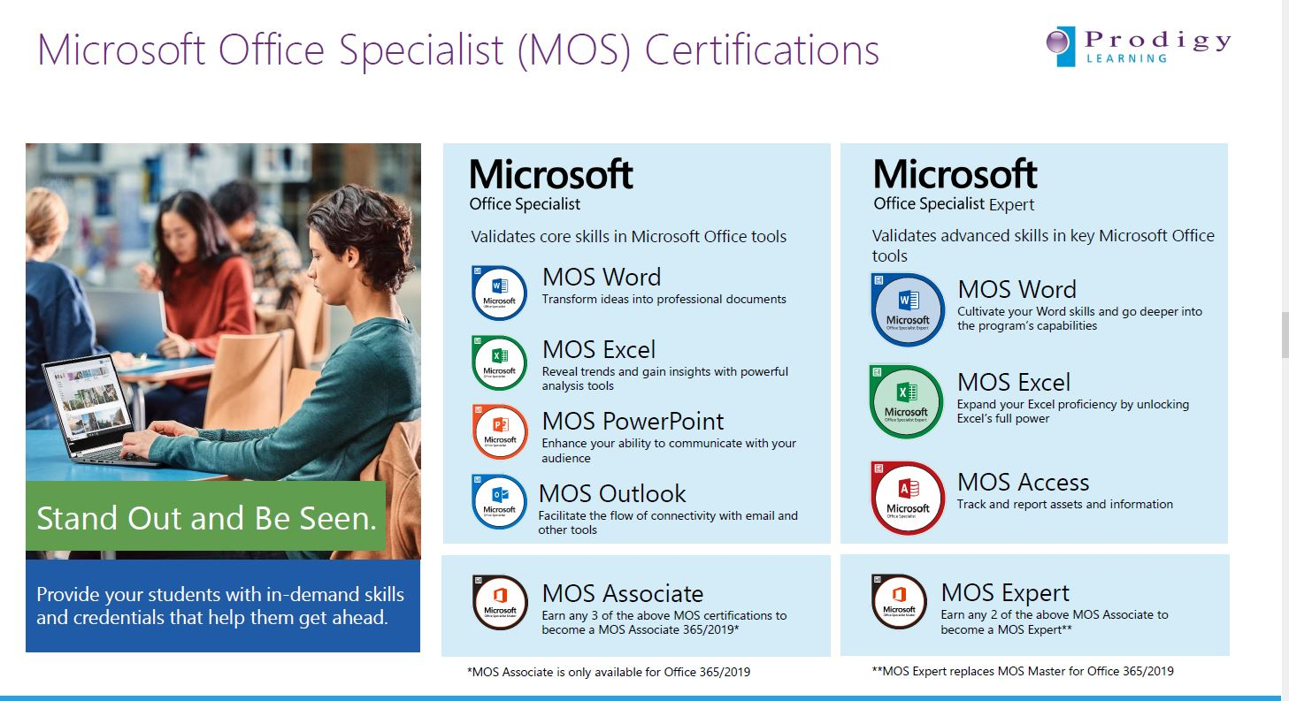
MOS Certifications

Slide 5
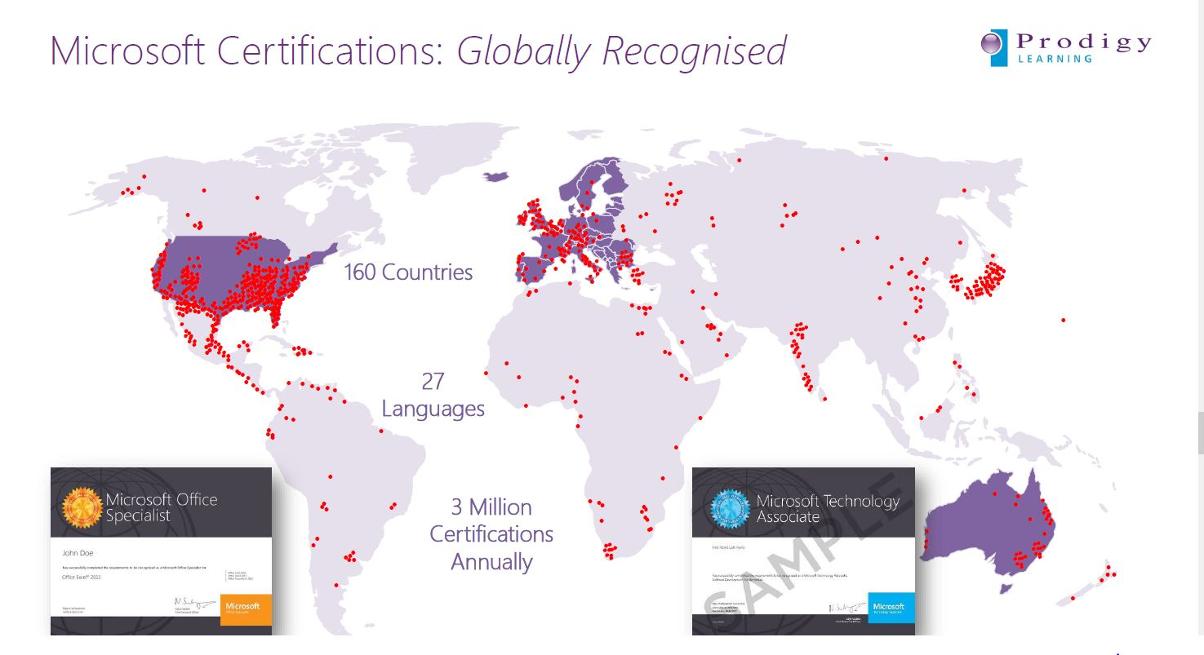
MOS Recognition is Worldwide……

