Slide 1
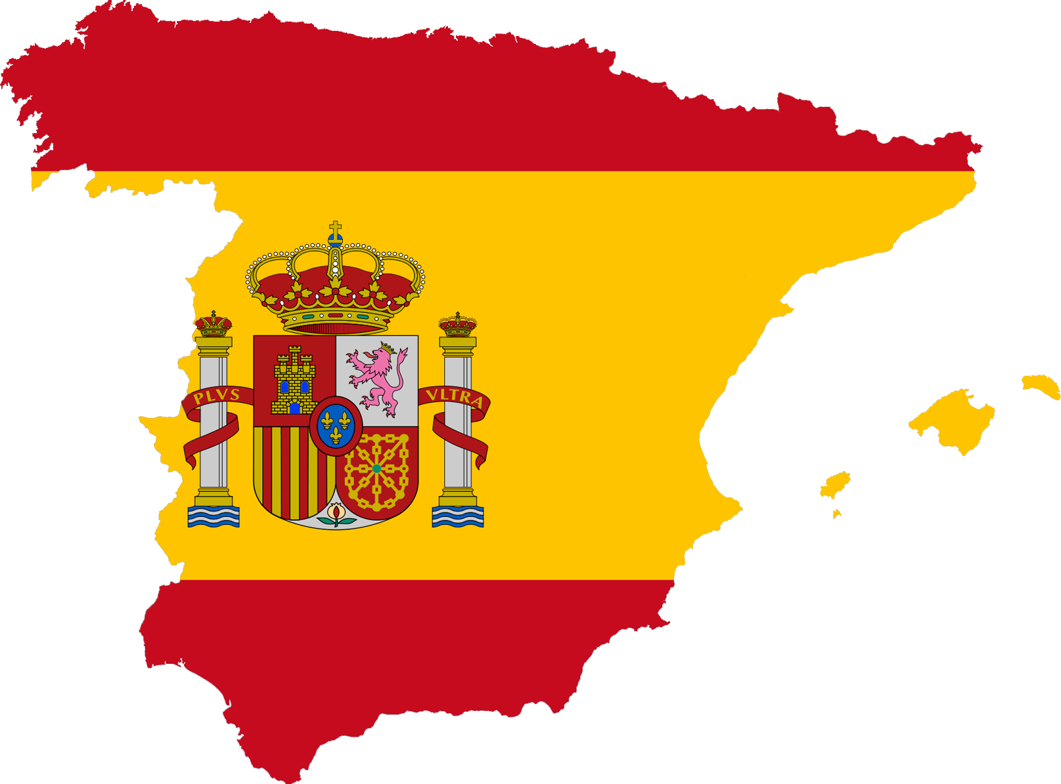
Español/Spanish
DEPARTMENT OF MODERN FOREIGN LANGUAGES
EUREKA SECONDARY SCHOOL, KELLS, COUNTY MEATH

Slide 2
Facts about Spanish
Spanish is the second most spoken language in the world after Mandarin Chinese.
Spanish is the most widely learned second language in the world.
It is spoken as a first language in over 20 countries.
More people speak Spanish as a first language than English.
By 2050, the United States will be the largest Spanish-speaking country in the world.

Slide 3
Why learn Spanish at Eureka?
Vibrant Department with Teachers committed to promoting Spanish within the school.
Students learn to effectively communicate in Spanish to both Junior Cert & Leaving Cert levels.
Students develop an awareness of Spanish & Hispanic culture.
Annual 2nd Year trip to Malaga.
Annual TY/5th Year trip to Cadiz where students stay with Spanish host families and attend a local school.
Opportunities to participate in national school debating competition; school Spanish Club and the school Spanish Book Club.

Slide 4
