Slide 1
At Eureka

Slide 2
What will you explore?
Use your creativity
Film study
Read a wide range of novels, plays and poetry

Slide 3
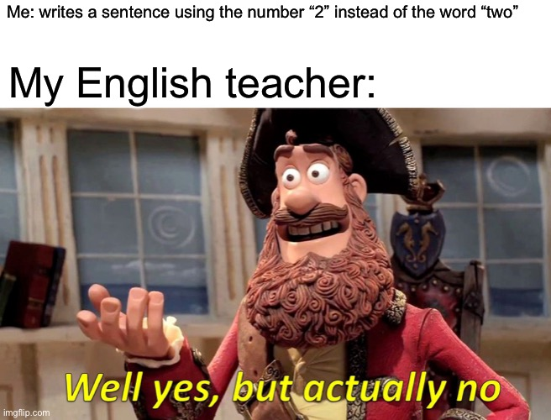
Getting creative
You will get the chance to write your own stories and poetry
You'll read your novels and get to recreate the ending
You'll use your creative writing to write; diary entries, letters, emails and short stories

Slide 4
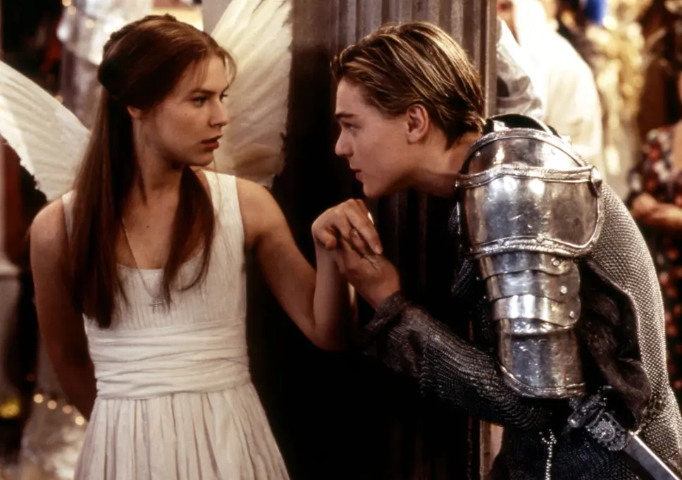
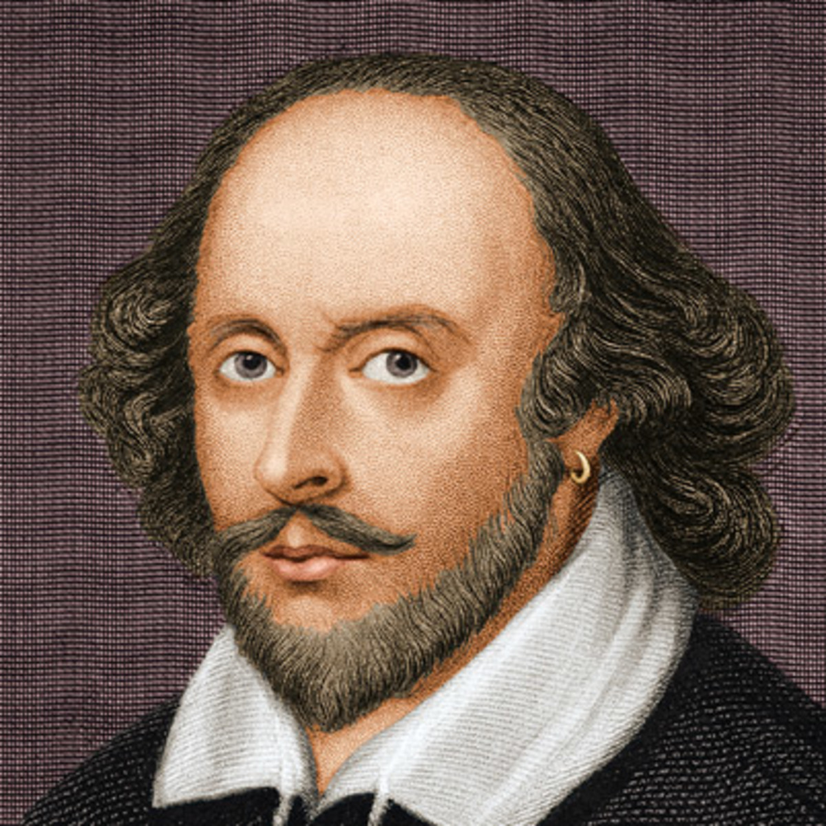
Some of the material you will discover in English

Slide 5
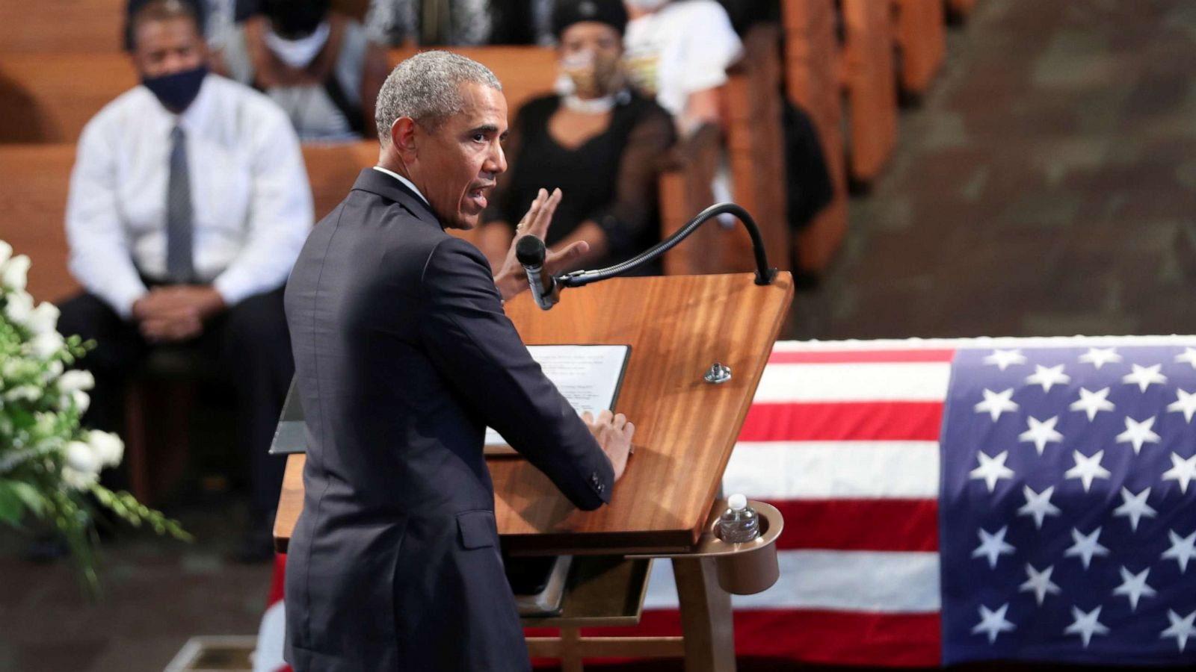
Debating: having interesting group discussions in English

Slide 6
Self-directed learning
In second and third year you will have opportunities in class to explore and present on topics that you love, no matter what your hobbies and interests are!

