Slide 1
How to make a webpage
HTML code
Adding Text
Editing text
Adding pictures
Making links

Slide 2
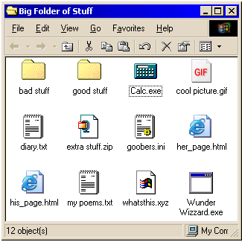
First though – some files

Slide 3
File extensions
.txt
.gif .jpg .bmp
.mpg .avi .wmv
.doc .pdf .ppt .xls
.exe
.wav .mp3
.html or .htm
Notes:
.txt- notepad, basic text
.gif- moving image, jpg- image, bmp- image
.mpg- video, avi- movie, wmv- video (windows often saves movie files with wmv
.doc- word, pdf- txt file you cant make changes to
.exe- how windows saves app’s
.wav- audio, mp3- smaller audio file
.html- webpage, htm- webpage

Slide 4
A web page is nothing more than a file, a HTML file to be exact. It's called HTML because web page documents have the file extension .html or .htm.
Hyper
Text
Mark-up
Language

Slide 5
What we need:
Notepad
Browser

Slide 6
Open notepad
<html>
</html>
Notes:
Tags. Usually have opening tag and closing tag. Which is the opening, which is the closing?

Slide 7
Now add the head tags
<html>
<head>
</head>
</html>
Notes:
Where in the doc do you think these will be? Head- Top of doc- info- title must be in the head. Heads are used to separate the main body of the file from the title.

Slide 8
In the head tags we need a title
<html>
<head>
<title></title>
</head>
</html>
Notes:
Title- what appears on the tab eg. ‘How to create an external webpage- for dummies’. Google will search the title.

Slide 9
Next the body tags
<html>
<head>
<title></title>
</head>
<body>
</body>
</html>
Notes:
Main bulk of the webpage- everything you see on the web page.

Slide 10
Add content
<title>My first web page!</title>
<body>Hello Everybody!</body>

Slide 11
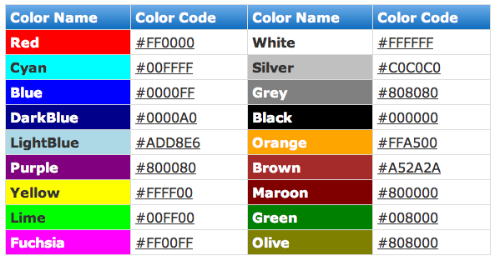
Lets change the colour
<body bgcolor="#ccffcc">
Notes:
Background colour

Slide 12
Make text bold, italics, underline
<body>Something really <b>cool</b></body>
<body>Something <i>really</i> <b>cool</b></body>
<body><u>Something</u> <i>really</i> <b>cool</b></body>

Slide 13
Change the font size, colour
<body>Something really <font size="6">cool</font></body>
<body>Something really <font color="#ff0000">cool</font></body>

Slide 14
Section headings
<h1>Something really cool</h1>
<h2>Something really cool</h2>
<h3>Something really cool</h3>
<h4>Something really cool</h4>
<h5>Something really cool</h5>
<h6>Something really cool</h6>

Slide 15
Align headings
<h2 align="left">Something really cool</h2>
<h2 align="center">Something really cool</h2>
<h2 align="right">Something really cool</h2>

Slide 16
Skip a line
<br>

Slide 17
Add an image
<body>
<img src=”name.extension” >
</body>
<body><img src=”name.ext" width="130" height="101"></body>

Slide 18
Let’s add a link:
<body>Go to Yahoo!</body>
Add anchor tabs:
<body>
Go to <a>Yahoo!</a>
</body>

Slide 19
To finish:
<body>
Go to
<a href="http://www.yahoo.com/">Yahoo!</a>
</body>

