Slide 1
Learning Support
Team teaching
Small Classes
Individual support plans

Slide 3
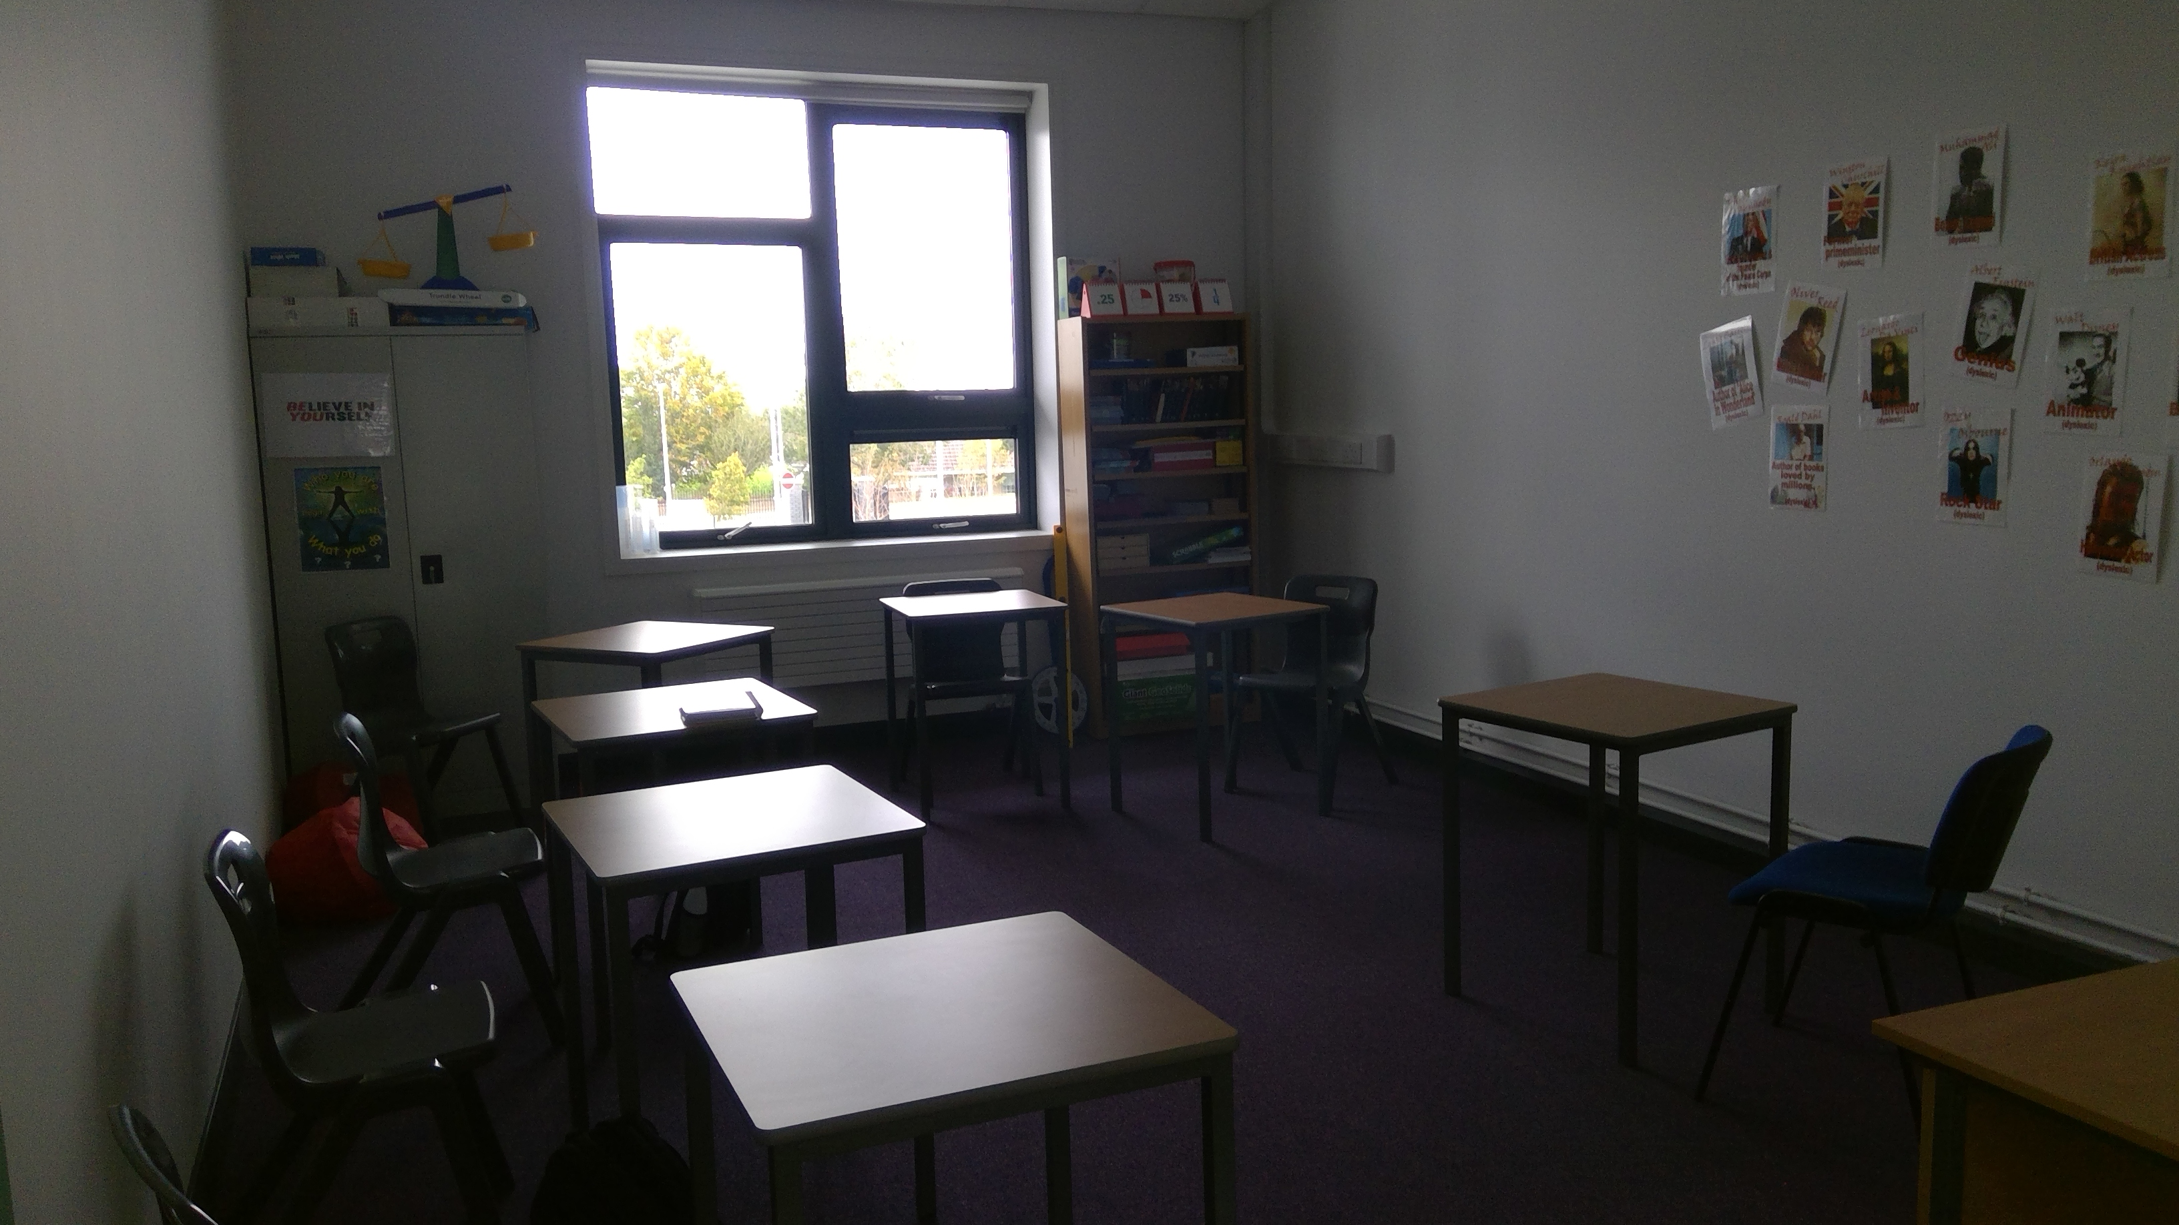
Learning Support Room

Slide 4
Supports in Eureka
In Eureka we are committed to inclusive education for all.
We offer differentiation in the classroom, small group support.
We adopt different learning styles.
We help students with social skills and resilience building.

Slide 5
Programmes students engage with:
Khan Academy.
Lexia Power Up
Lexia Core 5
Toe by Toe
Reading Laboratory
Friends for Life
Sparkles Comprehension

