Slide 1
What is School Self Evaluation?
Typical SSE Questions ….
How Good is Teaching in Eureka? And …..
How do we know???????? And …
What do we need to do to improve???????

Slide 2
3 Main SSE Strands
LITERACY Sept. 2013 – May 2016
NUMERACY Sept. 2014 – May 2017
ASSESSMENT FOR Sept. 2015 – May 2018
LEARNING

Slide 3
LITERACY STRATEGY 2013 - 2016
What is Literacy?????
..ie not JUST Reading and Writing…..
Literacy includes the capacity to read, understand and critically appreciate various forms of communication including spoken language, printed text, broadcast media, and digital media.

Slide 4
Inspection ask 3 Questions of both teachers and students:
WHAT are Literacy and Numeracy Targets?
WHAT Actions are you doing to reach Targets
WHAT is impact on students?
ie are they benefiting?

Slide 5
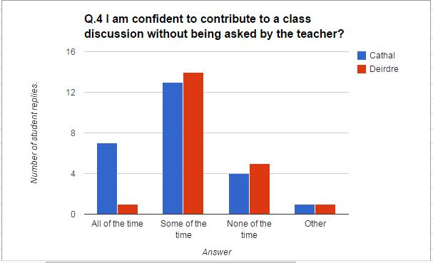
First Year Literacy Survey 2013 Results (1)
18% of surveyed students or 8 out of 45 expressed confidence in unprompted contributions to class discussions.

Slide 6
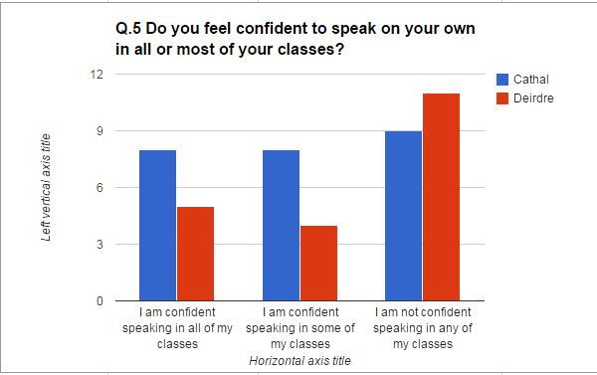
First Year Literacy Survey 2013 Results (2)
29% of surveyed students or 13 out of 45 were confident to speak on their own in all or most of their classes.

Slide 7
Revised Literacy Targets (2013 – 2016) and Recommended Actions to achieve Targets:
TARGET: IMPROVE ORACY TO EXTENT THAT 40% OF
STUDENTS ARE CONFIDENT IN SPEAKING IN CLASS.
(UP FROM 29%).
ACTION: STUDENTS TAKE PART IN GROUP PRESENTATIONS
PAIRED ...INDIVIDUAL.
EACH STUDENTS ASKS OR ANSWERS A MINIMUM
OF 2 QUESTIONS WEEKLY.
RE-INFORCE COMPREHENSION OF SUBJECTS’
KEY WORDS.
Notes:
Slide of Survey Results to assess weaknesses.

Slide 8
Revised Literacy Targets (2013 – 2016) and Recommended Actions to achieve Targets:
TARGET: IMPROVE STUDENT GRAMMAR AND
SPELLING.
ACTION: TEACHERS CORRECT FIRST 10 LINES OF
WRITTEN WORK INTENSELY.
TEACHERS USE GREEN PEN FOR CORRECTIONS.
Notes:
Dodgy ground here as only anecdotal evidence. Survey at end of First Year to assess? Impact of Green Pen? Less emphasis on grammar?

Slide 9
Revised Literacy Targets (2013 – 2016) and Recommended Actions to achieve Targets:
TARGET: IMPROVE STUDENT DIGITAL LITERACY TO
EXTENT THAT TYPING W.P.M. 30 WITH
90% ACCURACY.
ACTION: INTRODUCE ULTIMATE TYPING SOFTWARE TO JUNIOR CERT. AND
TY PUPILS.
Notes:
Mention online availability of package ie home and school for €5, excellent take-up.

Slide 10
Possible Strategies to implement Key Words Action:
KEY WORD DISPLAY IN EACH CLASSROOM
KEY WORD ‘QUIZZES’ EG 10 MINS. EACH FRIDAY
ONGOING REINFORCEMENT IN CLASSROOM
KEY WORDS JOURNAL/REVISION SHEET
USE OF GRAPHIC ORGANISERS TO PROMOTE KEYWORDS.
INCLUDE IN MARKING SCHEME FOR TERM TESTS
USE OF RUBRICS
Notes:
Ongoing in class; key to improving Oracy; student centred; ie not just twice a year testing.

Slide 11
Numeracy Strategy 2014 - 2017
What is Numeracy?
Numeracy encompasses the ability to use Mathematical Understanding
And Skills to:
Solve Problems and
Meet the demands of day-to-day living in
complex social settings.

Slide 12
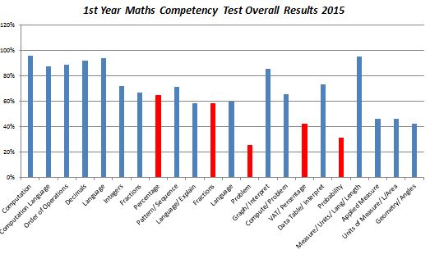
First Year Competency Results 2015

Slide 13
First Year Numeracy Survey Results 2013
Consistency in Numeracy Strategy
89% of non Maths teachers say there is not a consistent approach to numeracy across the school.
64% of students feel the same.

Slide 14
Numeracy Targets (2014 – 2017) and Recommended Actions to achieve Targets:
TARGET: Improve estimation skills, converting
fractions to percentages using a
calculator and ‘rounding off’ decimals
to the nearest whole number
ACTION: STUDENTS COMPLETE NUMERACY SHEETS
LEAST 3 TIMES ANNUALLY
STUDENTS COMPLETE KHAN ACADEMY
MISSION GOALS
Notes:
Chart to identify weaknesses; Note Numeracy Targets might vary from year to year according to Maths Competency Test Results

Slide 15
Numeracy Targets (2014 – 2017) and Recommended Actions to achieve Targets:
TARGET: To ensure THAT 50% OF STUDENTS FEEL THAT THERE IS A consistent approach to the teaching of Numeracy throughout the whole school community; UP FROM 36%.
ACTION: TEACHERS USE DIVISION FUNCTION TO
CALCULATE PERCENTAGES.
STUDENTS COMPLETE KHAN ACADEMY
MISSION GOALS
Notes:
Chart to illustrate issue re consistency; any other ideas to improve consistency in Numeracy Teaching??? ie agree targets and actions?

Slide 16
S.S.E. SUMMARY
2015/16 Actions:
First Year Maths Competency Test to be delivered on Monday next August 31st.
Second Year surveys of students and staff will indicate whether Lit. & Numeracy targets were met.
Numeracy Sheets and Pages 4-9 of Journals to be completed for both First and Second Year classes.
Literacy Actions to be completed for all Junior Cert. classes. Literacy posters to be displayed in all classes.
3rd Strand to be decided – probably re-inforce AFL practice. Staff surveys will determine.

Slide 17
The Learning Curve!!.....

